Slide 1


YOUR PATH TO BETTERMENT
V3.2
Notes:
Thanks so much for being here.

Slide 2


Youngevity is Your Path
to Opportunity
We are a global, publicly traded company
We’re building on our 20 years of experience to create a new kind of company
We help you customize the business that you want
Notes:
I’m with a company called Youngevity. We’re a publicly traded global company.
And although the company is celebrating its 20th anniversary - we’re starting a new chapter –
that’s very much in line with what’s happening in the market place today.

Slide 3

Youngevity
Changed
My Life
Add a brief
Statement about you
Notes:
OPTIONAL - CUSTOMIZE THIS SLIDE IMAGE FOR YOU. Add an image that is important to you and then enter a brief statement about you (i.e. I can now spend more time with my family)
This company has changed my life for the better in so many ways, and in my opinion – it can make everyone’s life better.
Add short personal story
DELETE THIS SLIDE IF YOU DO NOT WANT TO CUSTOMIZE

Slide 4

Youngevity
Changed
My Life
Notes:
This company has changed my life for the better in so many ways, and in my opinion – it can make everyone’s life better.
Add short personal story
DELETE THE PREVIOUS SLIDE IF YOU DO NOT CUSTOMIZE IT

Slide 5

Traditional Business
Has Changed
Growth of on-line shopping
Growth of social selling
By 2020 1 out of 2 people will be part of the
Gig Economy
Traditional retirement planning
no longer applies
Notes:
We’re an omni direct company. What does that mean?
We’re a part of 2 big trends – First the move away from buying products at retail (I mean, who doesn’t shop on on-line these days)…
And second the move away from traditional jobs and towards earning extra income on your own (I’m sure everyone has heard of Lyft and Airbnb). This is referred to as the gig economy.
This shift makes the “Traditional 40 year retirement plan” obsolete.
The gig economy (or new economy) is about a better life balance. Youngevity is about helping you get there.

Slide 6

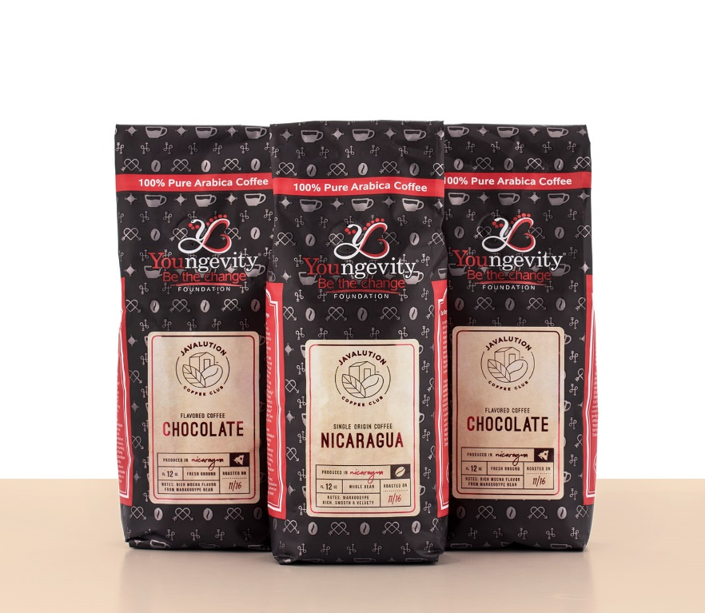
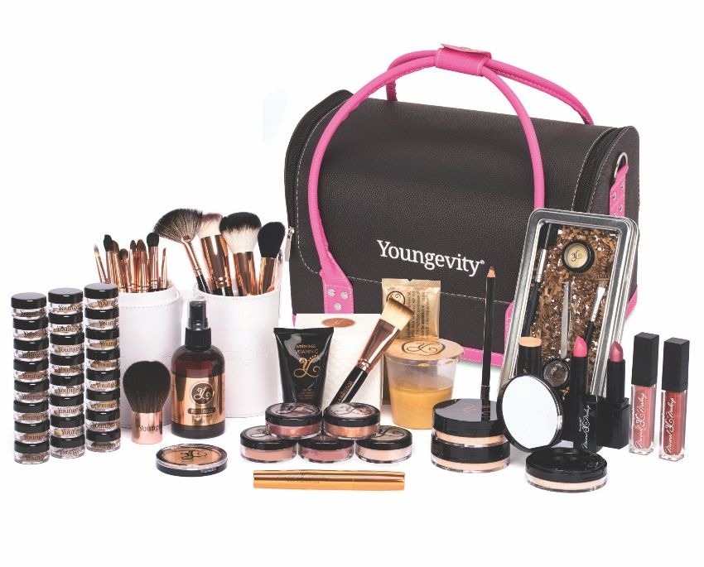
Something
For Everyone
Notes:
So let’s start with products.
Friend referrals, customer reviews – these are how most people decide if they want to buy something these days. So no impersonal retail stores for us…
We sell our products through a community of friends and families, who from personal experience with the products can make true recommendations.

Slide 7

Dr Joel Wallach
Founded Youngevity in 1997
Author of “Dead Doctors Don’t Lie” and more
90 For Life – 90 Essential Nutrients
Key in making selenium a required nutrient
Petitioned the FDA for authorized health claims
For a full list of the FDA Authorized Health Claims visit: www.fda.gov/Food/IngredientsPackagingLabeling/LabelingNutrition/ucm2006876.htm#Approved_Health_Claims
Notes:
Many people start with our nutrition and wellness products. There’s nothing like them and they're based on the philosophy of Dr. Wallach.
-published more than 75 times in medical and scientific journals internationally
-He’s famous for his research around the importance of 90 essential nutrients for optimal health.
-His research on selenium as a recognized essential nutrient led to the FDA creating a required daily amount of selenium
-he petitioned the FDA which resulted in Authorized Health Claims related to the safety and cancer risk reduction potential of Selenium
-the FDA has made it mandatory for baby food companies to add Selenium to ALL baby Formula.

Slide 8


Epigenetics
ep·i·ge·net·ics
/ˌepəjəˈnediks/
noun
The study of changes in organisms caused by modification of gene expression rather than alteration of the genetic code itself.
"epigenetics has transformed the way we think
about genomes"
Notes:
-and he was one of the first to talk about epigenetics . . . Which is such a hot topic these days.

Slide 9

Plant Derived
Minerals
The key to health is giving your body all the
90 essential nutrients it needs
Most mineral supplements are only
8 – 12% absorbable
Youngevity plant derived minerals
are up to 90% absorbable
Notes:
Most mineral supplements are derived from minerals that are 8-12% absorbable. But ours are much better. They’re plant derived and up to 98% absorbable.
Doc says:
“it’s not just what you eat that kills you, it’s what you don’t eat! The key to health is giving your body all the 90 essential nutrients it needs.”
Only Youngevity has exclusive access to a humic shale mine that supplies our unique plant derived minerals.

Slide 10
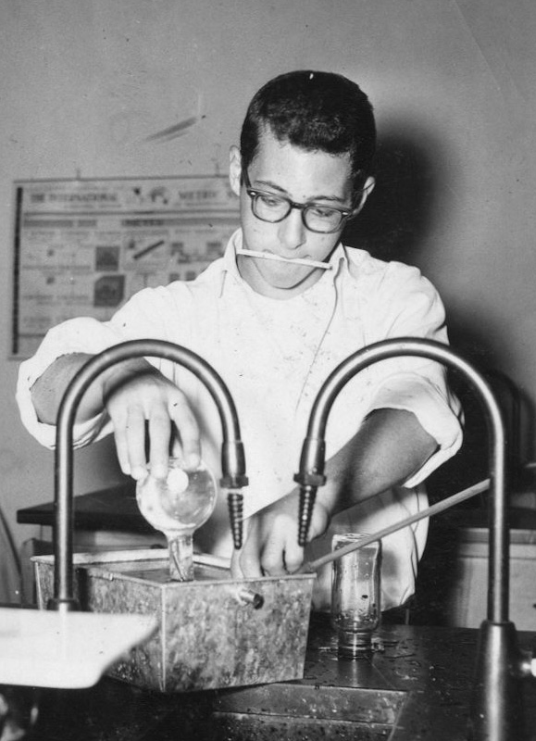
40 Years of
Research
Hundreds of thousands follow
Dr. Wallach’s nutritional advice
Top notch scientific advisory board
Top notch athletic advisory board
Notes:
Through 40 years of clinical research and discovery – there’s confirmation that each nutrient deficiency can be linked to multiple health issues.
Hundreds of thousands of people follow Dr. Wallach’s nutritional advice and truly believe their lives are better for it. As a result – we’ve got celebrity ambassadors who love our company, an amazing athletic advisory board, as well as a top notch scientific advisory board.

Slide 11




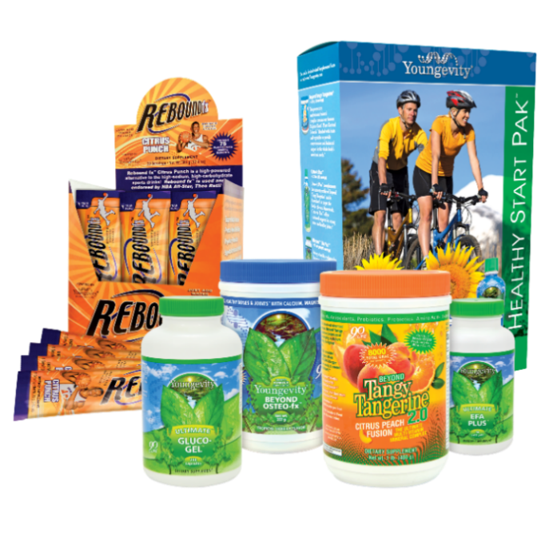


Healthy Body
Paks
No Wrong
Choice
Notes:
The core of our nutrition and wellness products starts with our Healthy Body Packs. They incorporate “90 for Life,” the foundation of all of our Healthy Body Paks.
People all over the world are part of 90 for life and are living healthier and happier.
We have 8 different Healthy Body Paks. Just pick the one that has the best focus for you. There’s no right or wrong choice. They all include the “90 Essential Nutrients.”

Slide 12
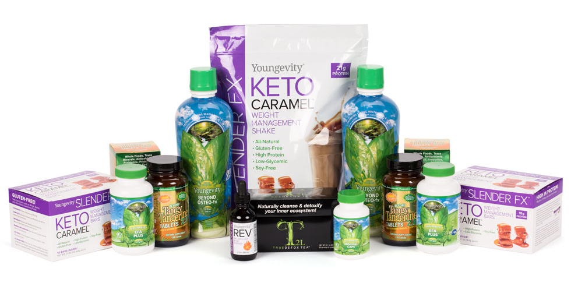
Nutrition is at
Our Core
Youngevity.com
Notes:
We have many other nutritional products that people rave about. You can check them out on youngevity.com (your replicated site info).
You can also update this slide, replacing Youngevity.com with your replicated site URL

Slide 13

The Youngevity Modern
Marketplace
6 top selling retail categories
  Nutrition & Wellness
  Memory Keeping
  Spa & Beauty
  Food & Beverage
  Apparel and Jewelry
  Services
Find out more at Youngevity.com
Notes:
Dr. Wallach also realized that emotional wellness is as important as physical – so we’ve created the Youngevity modern marketplace where you can find a broad assortment of product for mind, body and spirit.
Check out my website(your replicated site info)
We have products for
Home + Family
Spa and Beauty
Apparel and Jewelry
Food and Beverage
Services
And of course Health & Wellness

Slide 14
Youngevity
Modern
Marketplace
Nutrition
& Wellness
Notes:
You can zip through these category slides and stop to talk about you favorite products and services.

Slide 15

Youngevity
Modern
Marketplace
Home
& Family

Slide 16

Youngevity
Modern
Marketplace
Spa & Beauty

Slide 17



Youngevity
Modern
Marketplace
Apparel
& Jewelry

Slide 18
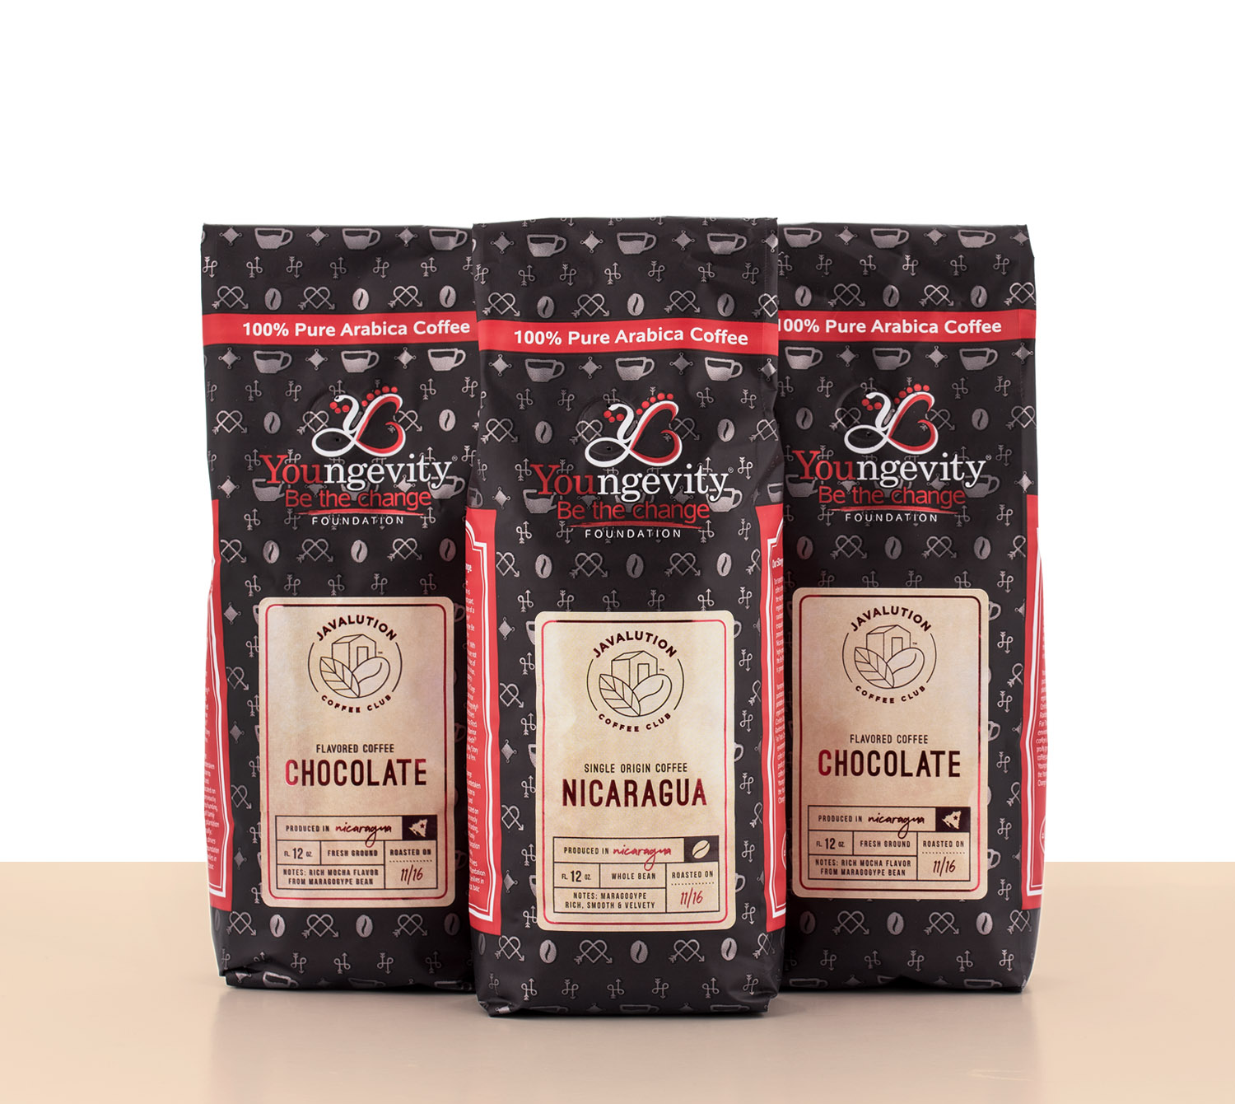
Youngevity
Modern
Marketplace
Food & Beverages

Slide 19




Youngevity
Modern
Marketplace
Services

Slide 20

Earn a Little
Extra
You set your hours
You work where you want
Make Youngevity your part time business or your full time job – You decide
Get paid weekly
Notes:
Now back to earning some extra money, and the Youngevity modern marketplace.
I’ve been able to earn enough to pay for my family’s gym membership and make the payments on my new car (insert own story)
And I don’t have to stick to any crazy hours on top of my regular job… I just fit this in when I can. It’s flexible. I’m doing something fun on the side. And I’m getting paid for it.
There are other companies that offer ways to earn money by sharing their products. This is becoming more mainstream. But they don’t have the variety we do. You can represent products and services in the 6 top billion dollar industries.

Slide 21

The Youngevity Modern
Marketplace
#PickYourPassion
#SwapWhereYouShop
Notes:
And because of this unique assortment, you can “Pick Your Passion” – choose what you want to focus on. In addition to letting people know about the Healthy Body Paks . . .
I actually do fun oil workshops. (fill in your own)
And because of this broad assortment, it’s much easier to find people who want to buy something from you. And then, you’ll be able to simply help people “Swap Where They Shop” because we offer so many every day items they purchase elsewhere.

Slide 22

How do I Get Started?
$25 Membership
  Wholesale pricing
  Free shipping on autoship
  Earn “Thank you checks”
Go CEO for $499
  Enjoy membership benefits
  plus more!
  $500 in great products
  Get paid 10 different ways
Notes:
There are two options:
So if you’re interested in making an additional $500 - $1000 a month – then think about joining us as an associate. WE have all the tools for success. It’s like starting a business – but setting up the business is all taken care of for you.
And there is no inventory!
$25 membership that gets you
-wholesale pricing
-free shipping on autoship
-thank you checks
Go CEO for $499
-membership benefits
-$500 in great products
-get paid 10 different ways (listed out on next slide)

Slide 23

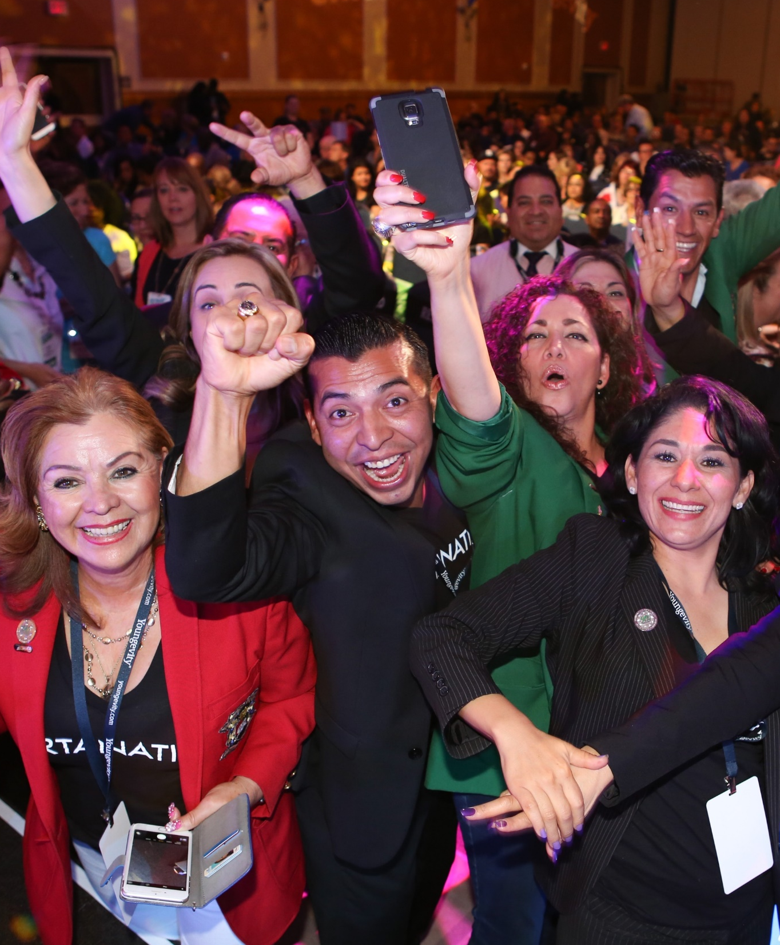
Get Paid in 10 Different Ways
1. Retail Profits
2. Quick start bonus
3. Fast start bonus
4. Team commissions
5. Coding bonuses
6. Leadership bonus
7. Car bonus
8. Revenue sharing
9. Product credits
10. Dream car giveaway
Notes:
Get paid in 10 different ways!

Slide 24

Fast Track
For Success
CEO
MEGA
PAK™
CEO
MEGA
PAK™
CEO
MEGA
PAK™
CEO
MEGA
PAK™
+
+
+
$400 + $192 = $592
Fast Start
Bonuses
Commissions
Total
*Total value received, including commission bonuses.
For illustration purposes only. Actual results may vary based upon Coding group and other factors. Assumes enroller has $100 Autoship.
Notes:
If you can get 4 people to join your team and purchase a CEO Pak then in this example, you can get your money back on the purchase of your
own CEO Pak, enjoy the benefits of the great Youngevity products, and start your business quickly.

Slide 25

Getting Paid Basics
Fast Start, Quick Start & 1st Stage of Coding Bonuses
Number of Customers* | Minimum Commission | Number of CEO Packs | Minimum Commission | Min. Monthly Income
1 | $45 | 1 | $148 | $193
2 | $90 | 2 | $296 | $386
3 | $135 | 3 | $444 | $579
4 | $180 | 4 | $592 | $772
5 | $225 | 5 | $740 | $965
*Sales Associate with avg. customer order value 150 BV
Potential commissions in this example are based on earnings from Quick Start, Fast Start, Residual and 1st stage of Coding Bonuses. Youngevity prohibits distributor income claims; each distributor's earnings, if at all, will vary based on differing economic and demographic conditions.
Notes:
Here’s an example of how it is possible to earn $500 a month by adding customers and distributors to your business.
This is great place for a personal story or testimonial from your team.
You want people to believe this is achievable and you have the team to support them.

Slide 26

Monthly Residual Bonus
What is your goal?
Level | Level % | Distributors & Customers | BV | Monthly Commissions
1 | 8% | 4 | 600 | $48
2 | 8% | 16 | 2,400 | $192
3 | 7% | 64 | 9,600 | $672
4 | 6% | 256 | 38,400 | $2,304
5 | 6%
6 | 8%
7 | 4%
8 | 4%
*For training and illustration purposes only. Actual results may vary based upon many factors. Monthly residual based on 150BV at all distributor and customers positions.
Notes:
Here’s an example of the monthly residual bonus.
This is another great place for a personal story or testimonial from your team.

Slide 27
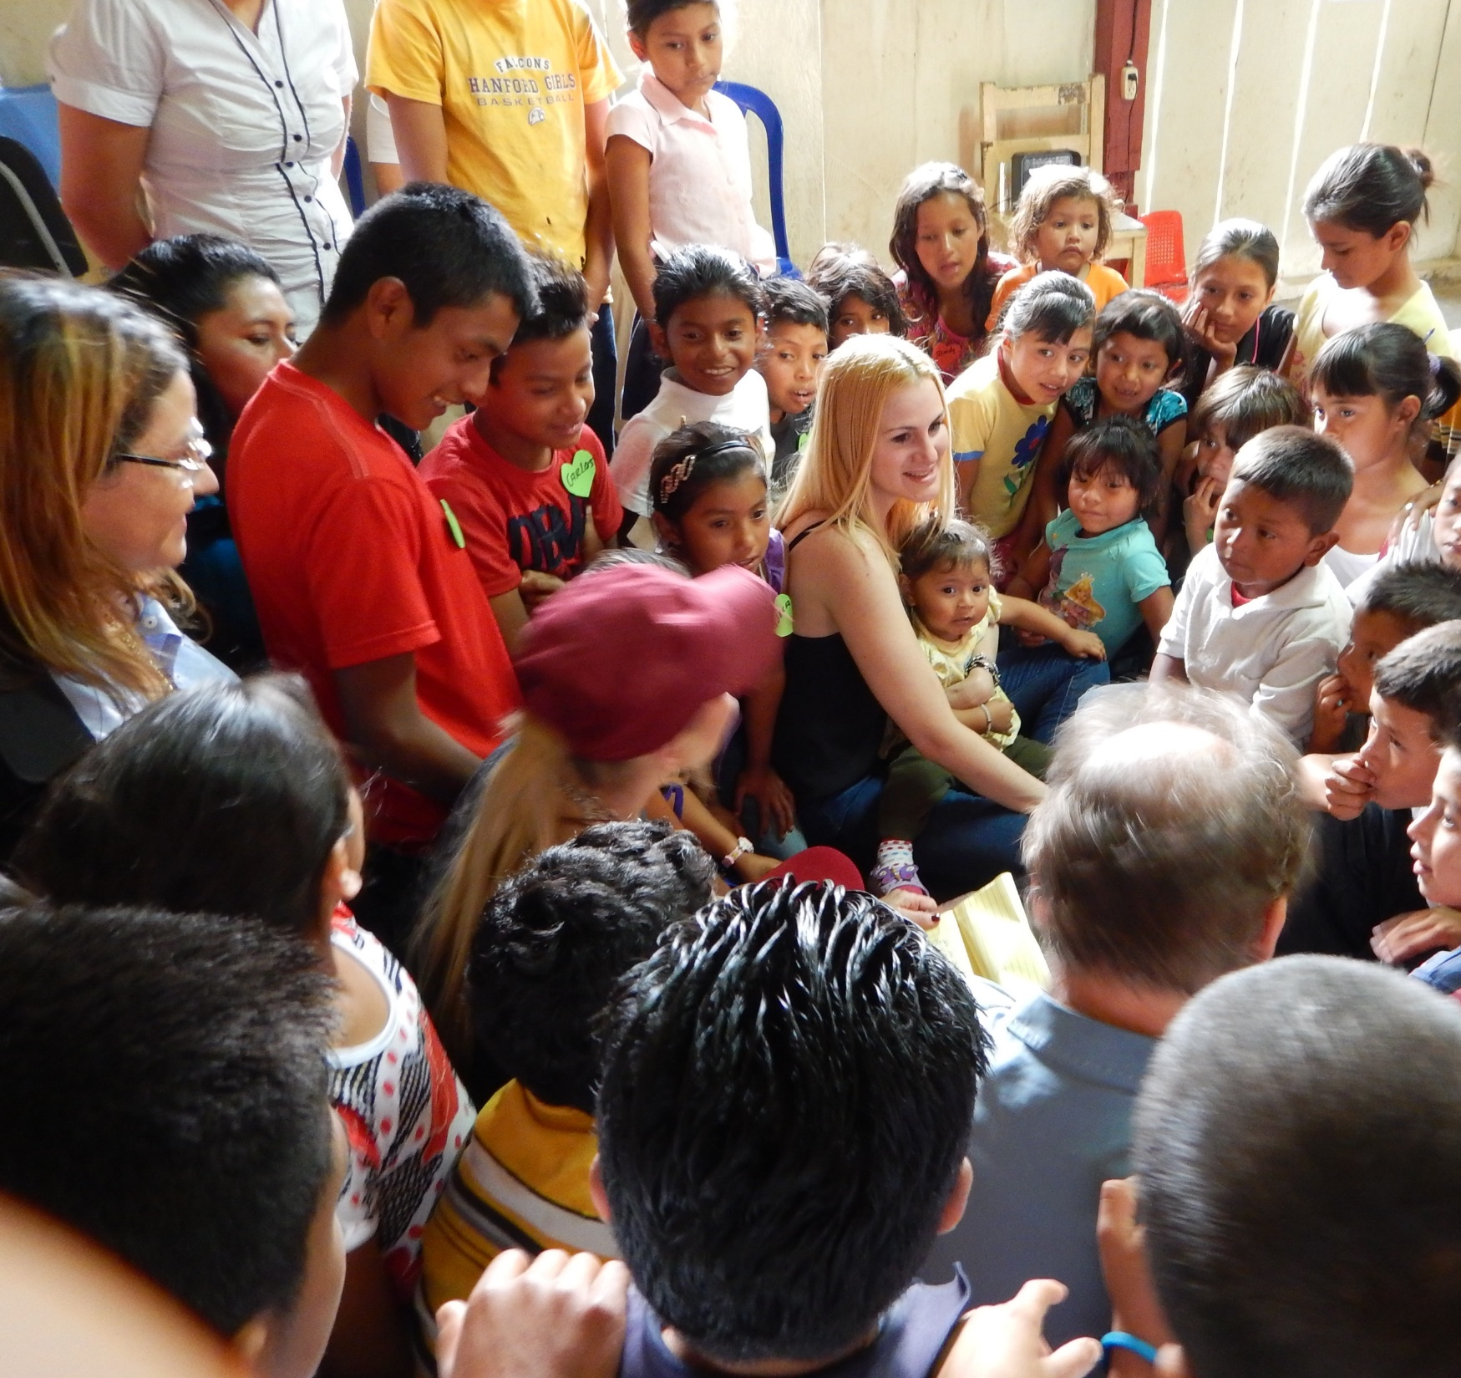
Be the Change Foundation
Products help fund foundation
Supports a number of charities
We put others first on the 1st day of each month and call it #RAK Day
Random Acts of Kindness #RAK – You serve your community your way
Notes:
But I have to tell you that what I really love about being a part of this company is the community. WE help each other get better – and do better. For me, I’m always looking for ways to improve my quality of life – and the quality of life of my family and my community.
You saw the slide with coffee on it. Well that’s one of the products that helps fund our Be the Change foundation.
I love being a part of a company that gives back in so many ways. In fact all of our events include some act of kindness in the community. And they're always one of the most popular activities. You can read more about this on my site too. I’m just so proud to be associated with this great foundation.

Slide 28

Youngevity
Rewards
Pick your passion. Pick your rewards
You pick the rewards, you want!
Cash incentives
Once in a lifetime trips
Top Achiever’s Club
Notes:
And the other benefits of being a part of this community are the fun rewards and incentives you can earn – like amazing trips.
My husband and I look forward to the Top Achievers trip every year. It has become our annual vacation – that otherwise, we’d never be able to afford.

Slide 29
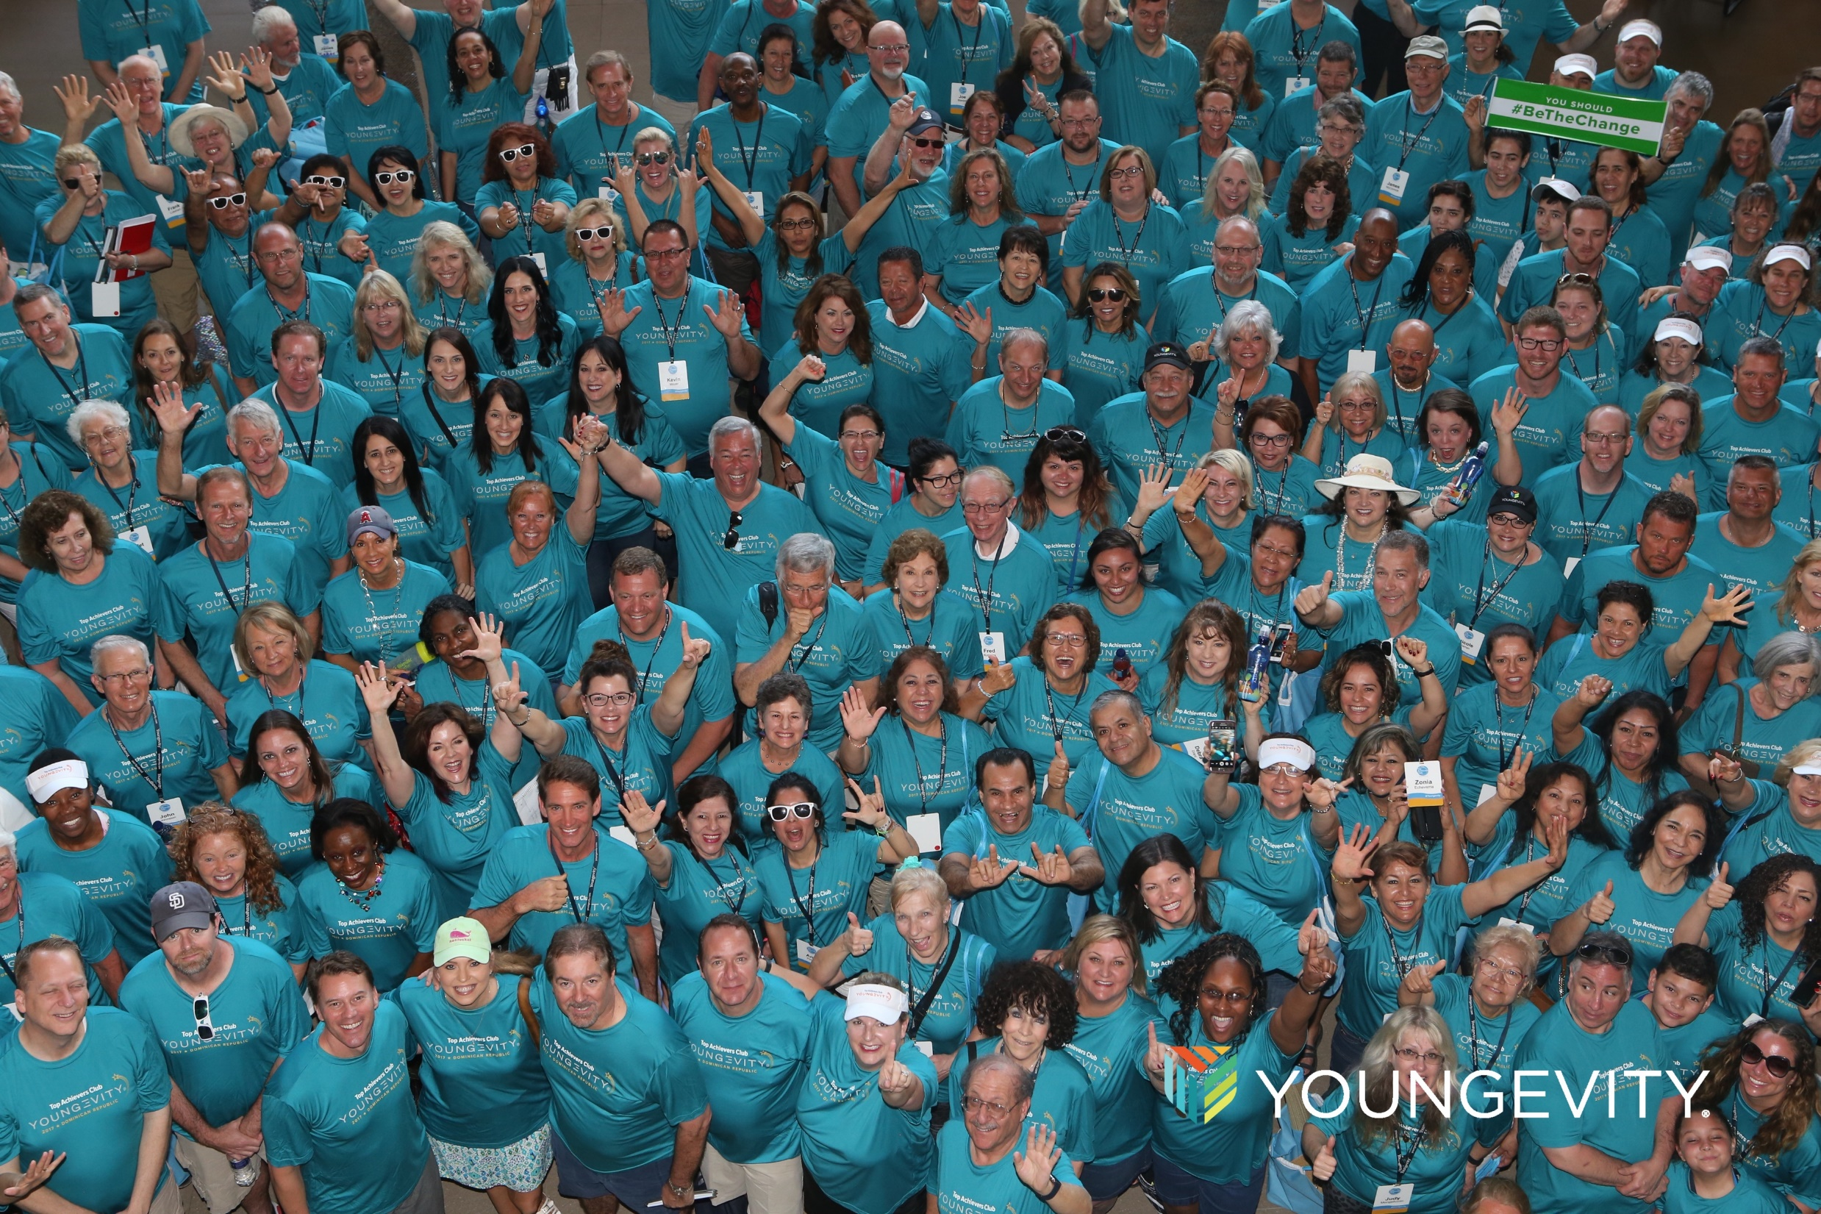
Youngevity is Your Path
to Opportunity
We have the products and services that give you the best chance for success
Built on 20 years of success
A community to support you
Part of the New Economy
  You decide if you want to earn a little extra income, or full time income
  100% satisfaction guarantee
Notes:
Review key points and remind your audience how Youngevity has helped you

Slide 30

Ok! Let’s Get Started
Get the CEO or Product Pack that’s
right for you.
Become a Youngevity Associate
Schedule some time with me so I can answer any questions

Slide 31
YOUR PATH TO BETTERMENT
V3.1
Notes:
Thanks so much for your time. I’ll meet you in the back :)

Slide 32

Food and dietary supplement products sold by Youngevity are intended to contribute to
the daily diet and overall health and are not intended for use in the prevention, treatment, mitigation, or cure of any disease or health related condition. Individuals who have or suspect they have an illness or who wish to commence a diet or exercise program should consult
an appropriately licensed health care practitioner for a medical history evaluation,
diagnosis, treatment, and health recommendations.
Youngevity prohibits its distributors from making income earning claims in association
with the promotion of Youngevity business opportunities. Whether an individual who becomes a Youngevity distributor will earn more than he or she pays for the business opportunity depends on multiple independent and dependent variables that are
impossible to predict, such as economic factors unique to each location where
product sales are attempted and the sales talents of each individual distributor.

Slide 33
Optional slides

Slide 34
4% Financially
Stable
1% Wealthy
5% Still
Working
The 40 Year Plan
For every 100 people who reach the age of 65
28% Dead
62% Dead
Broke
Notes:
Add this optional slide around slide 5

Slide 35
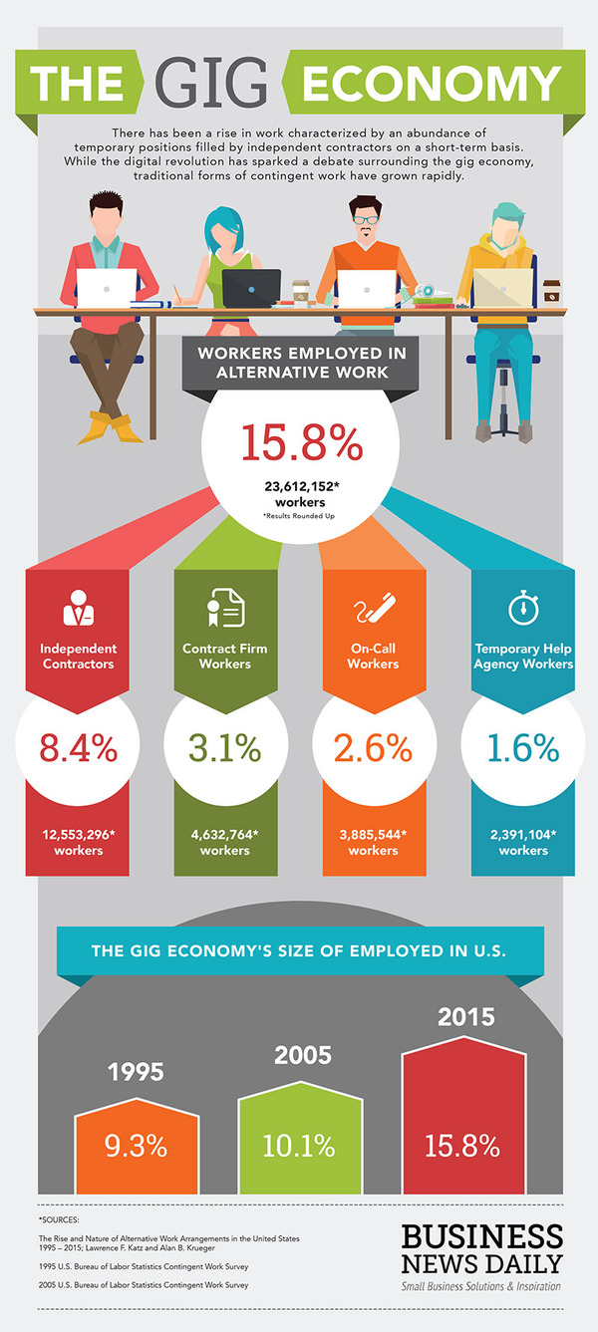
The Gig Economy
In the Gig Economy traditional
“Corporate” long term jobs
are vanishing
But short and flexible opportunities are growing
Currently 1 out of 3 Americans work as part of the Gig Economy
By 2020 half of all Americans will work as a part of the Gig Economy
Notes:
If you want to add this optional slide we suggest you add it around slide 4 or 5

Slide 36
Health & Nutrition
KETO CEO Mega Pak

Slide 37
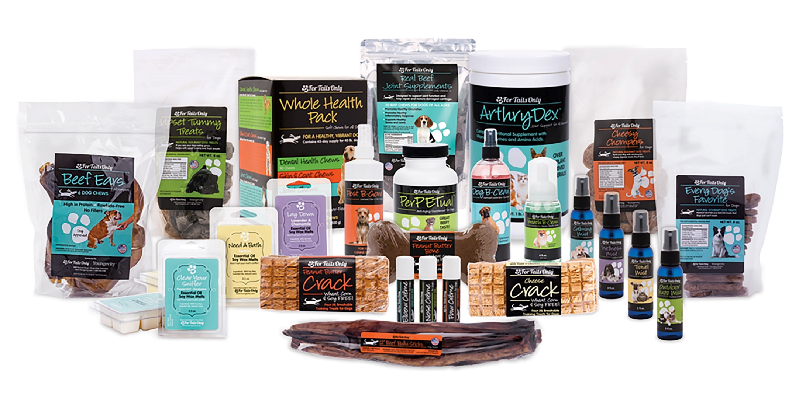
Home & Family
For Tails Only CEO Mega Pak

Slide 38

Food & Beverage
Also Includes:
On-The-Go
Ultimate Cardio
On-The-Go (1)
Health Body Start Pak 2.0 (2)
Rebound Fx
Citrus Punch Stick Pak (30ct.)
GOFoods CEO Mega Pak

Slide 39
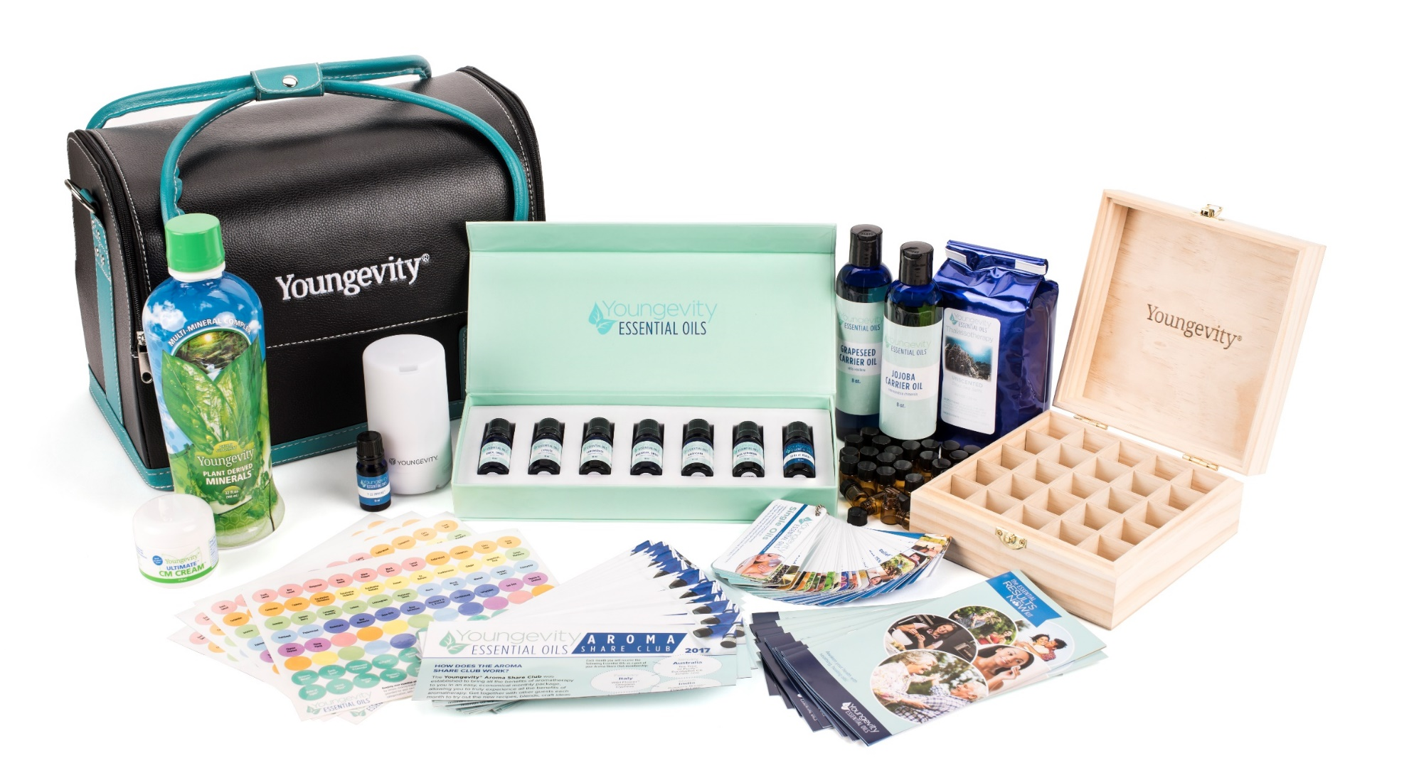
Spa & Beauty
Essential Oils CEO Mega Pak

Slide 40
Apparel & Jewelry
Mialisia CEO Mega Pack

